Slide 1

EXAMGUARD AI
AI-Powered Intelligent Online Exam Invigilator
"Making Online Exams Fair, Secure, and Intelligent
with Physical Perception AI."
HACK AARAMBH 2026

Slide 2
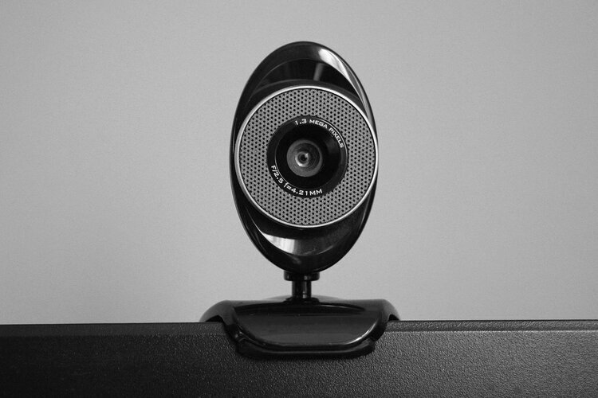
THE CHALLENGE
Online examinations continue to face serious integrity issues.
Students use mobile phones during exams
Multiple people can enter the room undetected
Students frequently look away to read notes
Teachers cannot monitor hundreds of students simultaneously
Reviewing hours of recorded videos is time-consuming
Existing systems generate too many false alarms
RESULT
Online exams become unreliable and difficult to trust.
02

Slide 3

OUR SOLUTION
ExamGuard AI
An AI-powered invigilation platform that uses Afferens Vision API to understand the student's physical environment in real time.
▶ Detects suspicious activities
▶ Understands context
▶ Calculates cheating risk
▶ Generates evidence
▶ Explains every decision
▶ Helps teachers monitor exams efficiently
03

Slide 4
HOW IT WORKS
1 Student Starts Exam
2 Webcam + Microphone
3 Afferens Vision API
4 AI Reasoning Engine
5 Risk Analysis
6 Warning / Alert
7 Teacher Dashboard
8 Final AI Report
04

Slide 5
KEY FEATURES
AI DETECTION
Face Verification
Camera Blocking Detection
Multiple Person Detection
Suspicious Object Detection
Mobile Phone Detection
Voice Activity Detection
Looking Away Detection
Room Monitoring
Student Leaves Seat
AI INTELLIGENCE
Live Risk Score
Explainable AI
Auto Warnings
Event Timeline
Real-time cheating risk calculation
Every decision explained clearly
Instant alerts for suspicious activity
Complete incident chronology
05

Slide 6
TECHNOLOGY STACK
FRONTEND
BACKEND
DATABASE
Next.js
React
Tailwind CSS
TypeScript
FastAPI
Python
Supabase
AI
DEPLOYMENT
OpenAI
Afferens Vision API
Vercel
06

Slide 7
WHY WE'RE DIFFERENT
Feature | Traditional Proctoring | ExamGuard AI
Detection Method | Records video only | Understands environment
Rule System | Fixed rules | AI reasoning
Alert Accuracy | Many false alerts | Context-aware detection
Review Process | Manual review | AI explanations
Monitoring Depth | Simple monitoring | Physical perception + intelligent actions
07

Slide 8
AI WORKFLOW
1
2
3
4
5
6
7
8
Student joins
exam
AI verifies
identity
Environment
scan
Live
monitoring
Risk score
calculation
Real-time
warning
Teacher
notification
Automatic
PDF report
END-TO-END PROCESS
The AI workflow ensures complete exam integrity from start to finish. When a student joins, the system immediately verifies their identity through facial recognition. The environment is scanned for unauthorized objects or people. Throughout the exam, the AI continuously monitors behavior patterns, calculating a live risk score. If suspicious activity is detected, real-time warnings are issued and teachers are notified instantly. After the exam, a comprehensive PDF report is automatically generated with full evidence and explanations.
08

Slide 9
IMPACT
FOR STUDENTS
FOR TEACHERS
FOR INSTITUTIONS
▶ Fair examination
▶ Reduced false accusations
▶ Transparent monitoring
▶ Live monitoring
▶ Automatic evidence
▶ Saves time
▶ AI-generated reports
▶ Improved credibility
▶ Reduced cheating
▶ Better exam quality
▶ Easy scalability
09

Slide 10
THANK YOU
EXAMGUARD AI
FUTURE SCOPE
Multi-camera monitoring
AI interview monitoring
Offline exam support
LMS integration
Mobile application
University ERP integration
Government exam support
Corporate assessment
"Building Trust in Online Examinations
through AI Physical Perception."
HACK AARAMBH 2026

